Slide 1
Hello !
We are GROUP 16
Github: https://github.com/chalovina/Group16/tree/master/Group16_MppProject
Demo Video: https://www.youtube.com/watch?v=DoL4I_s_dPo

Slide 2
All features are implemented (including extra optional parts)
Basic features
Login
Checkout
Add copy
Add library member
Optional extra features
Add book
Search and print checkout entry record
Search and print overdue checkout

Slide 3
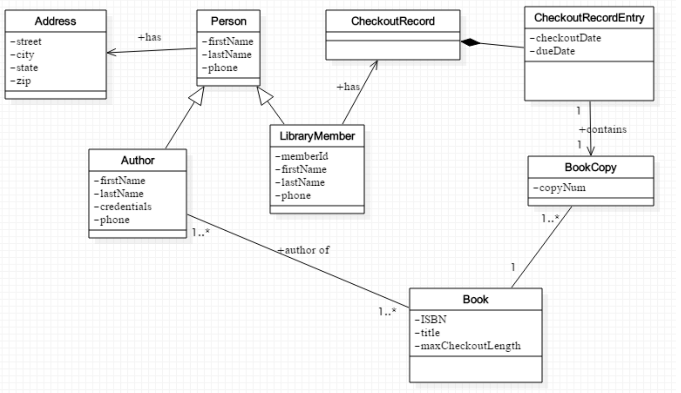
Overview Diagram (Basic)

Slide 4
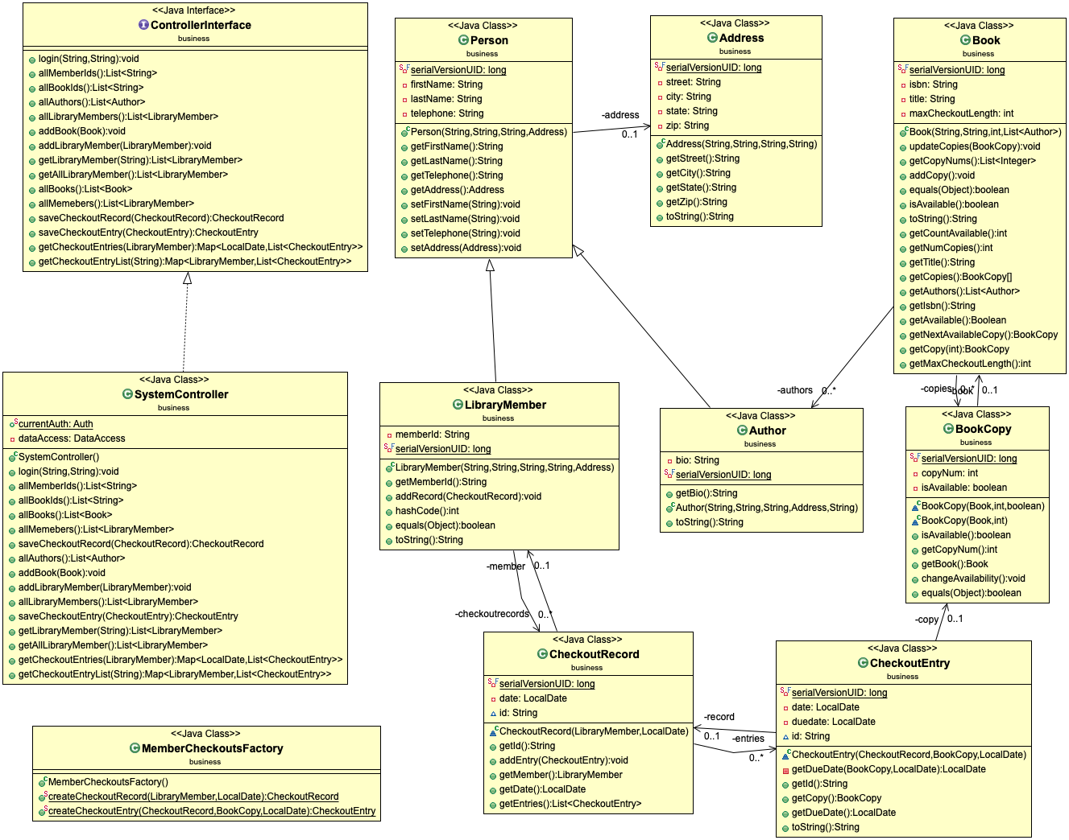
Overview Diagram (extended)

Slide 5
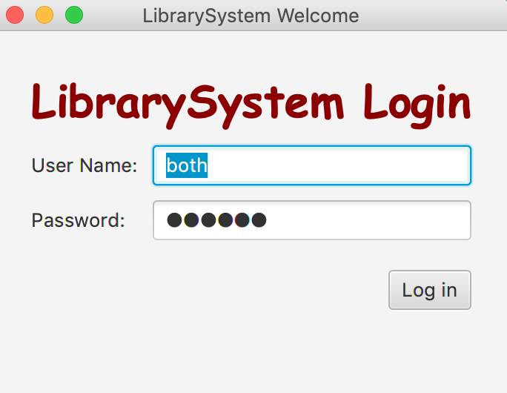
1.LOGIN
Difference roles: Super Admin: both
Admin: admin
Librarian: lib

Slide 6
LOGIN
Use Case Description:
User Action | System Response
1. User enters username and password, then clicks login | 1. System checks validity of login information and presents the Main Window. The main window presents the options which are depended on the authorization level of user returned with 3 level of LIBRARIAN, ADMIN, and BOTH. - LIBRARIAN level includes options: Checkout Book, Print Checkout Record, and Overdue Checkout. - ADMIN level includes options: Add Member, Add Book, and Add Copy. - BOTH level includes the options of both LIBRARIAN and ADMIN.

Slide 7
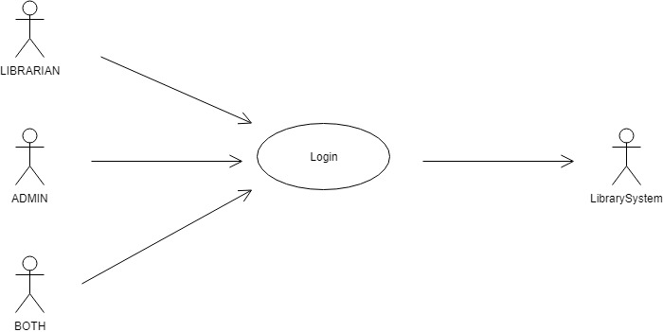
LOGIN
Use Case:

Slide 8
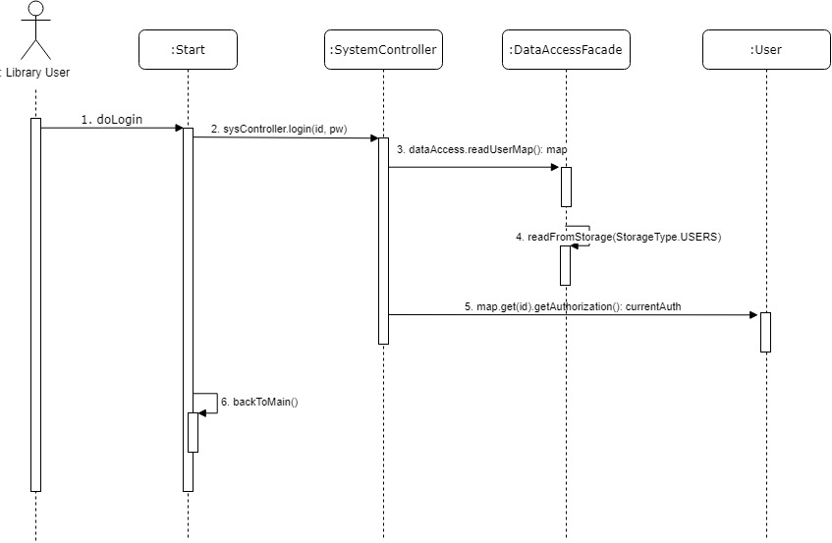
LOGIN
Sequence diagram:

Slide 9
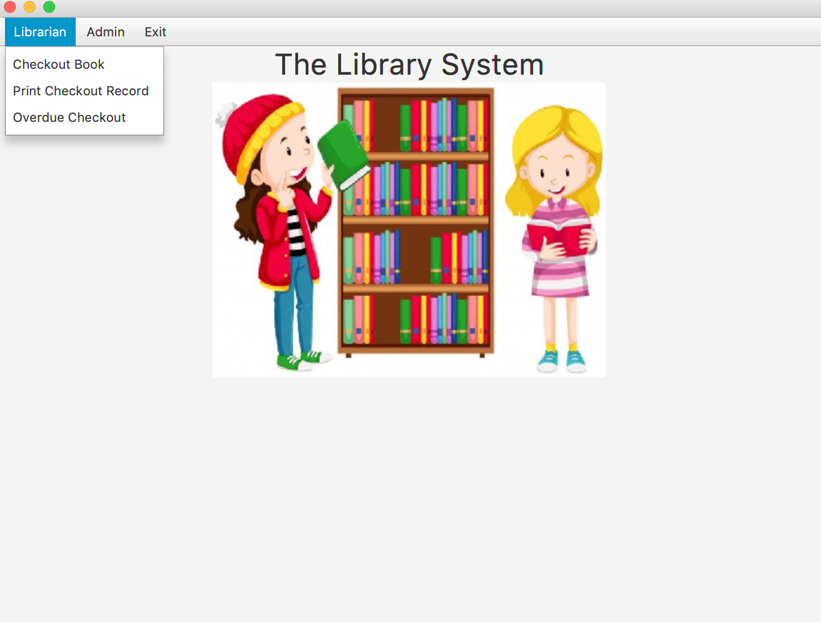
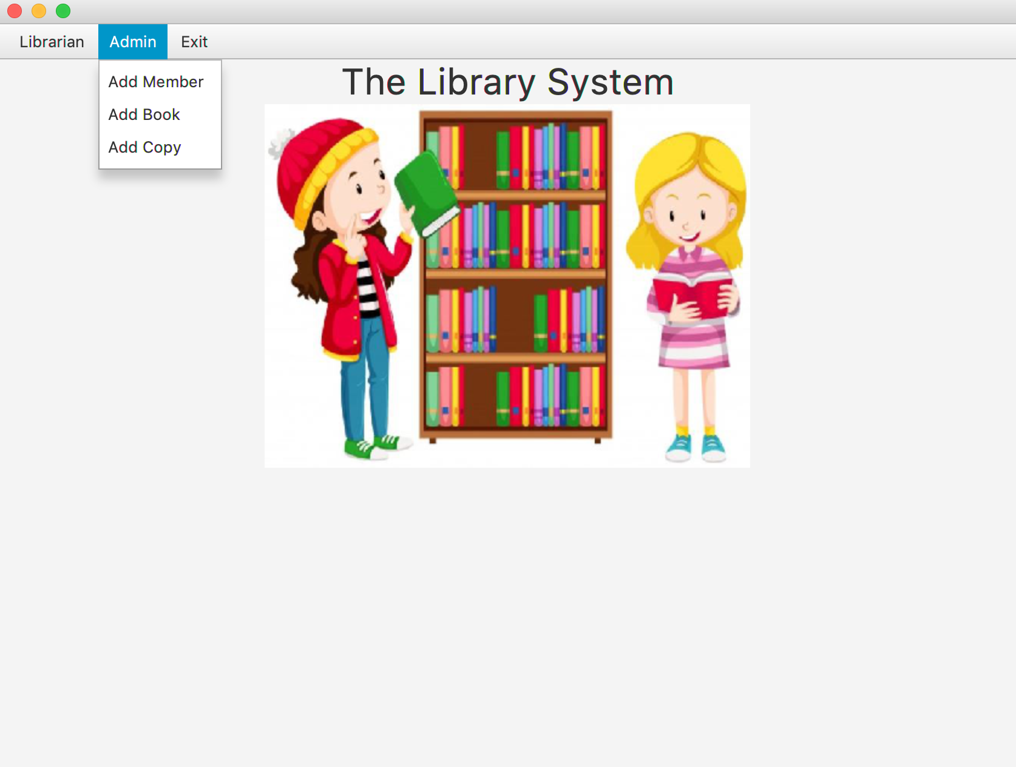
Super admin view
Super admin has fully permission for role: Admin and Librarian

Slide 10
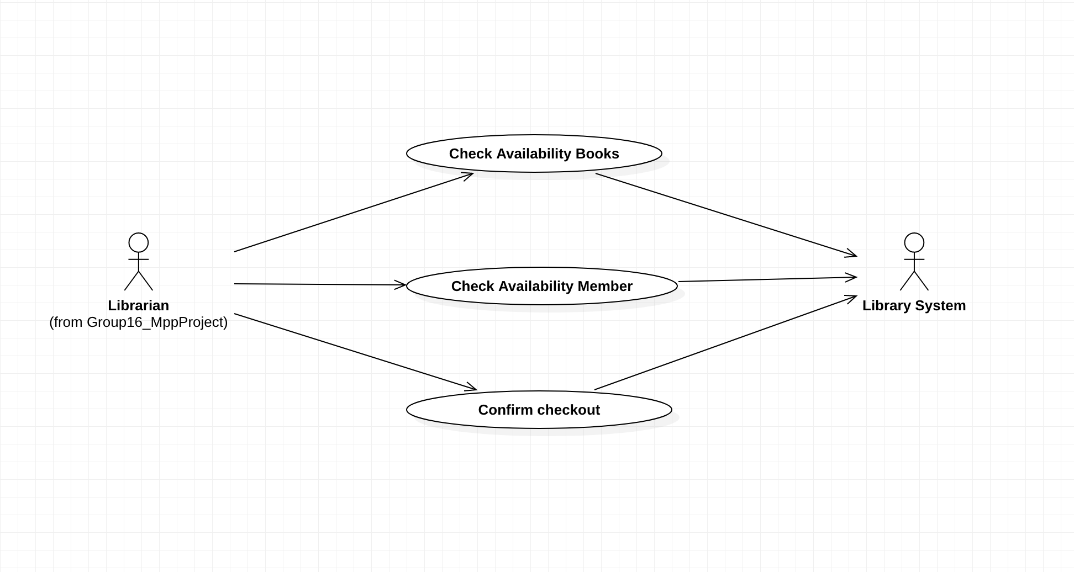
Checkout, Use case

Slide 11
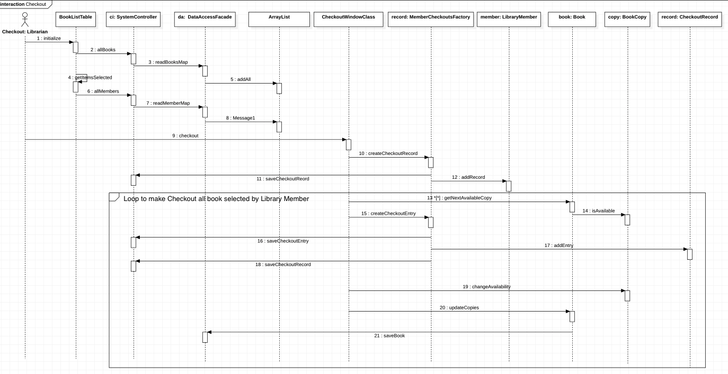
Checkout, Sequence Diagram

Slide 12
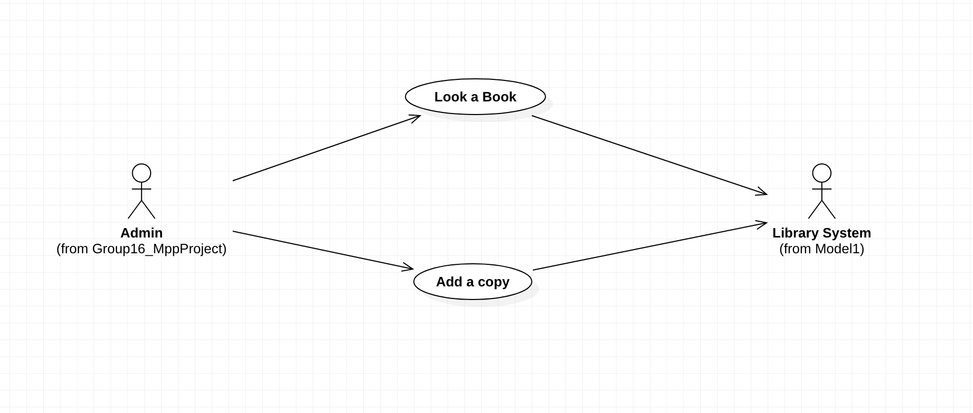
Add a Copy, Use case

Slide 13
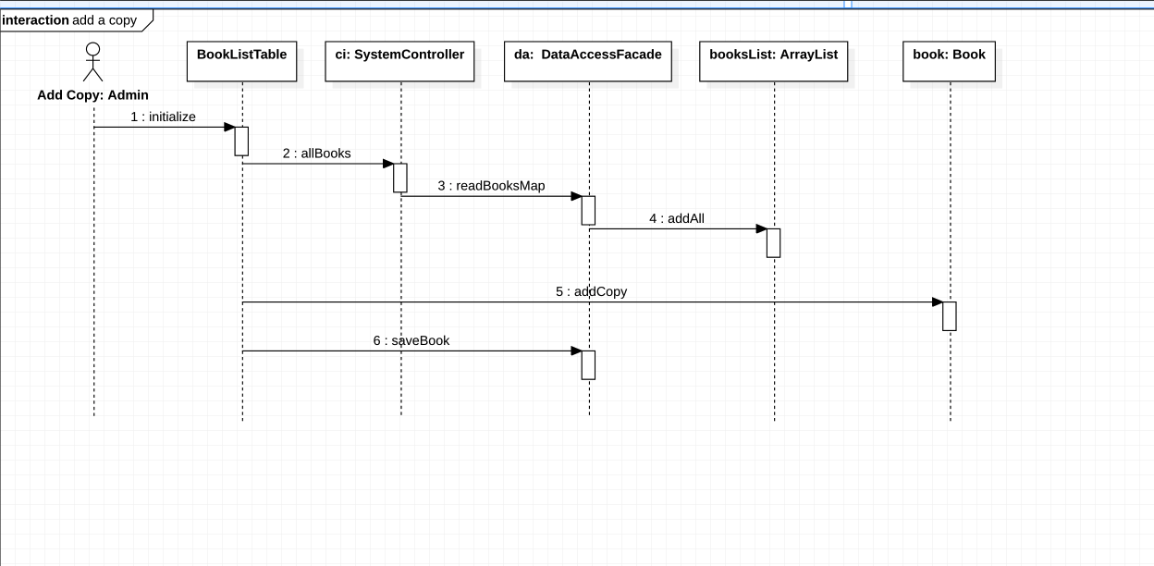
Add a Copy, Sequence Diagram

Slide 14
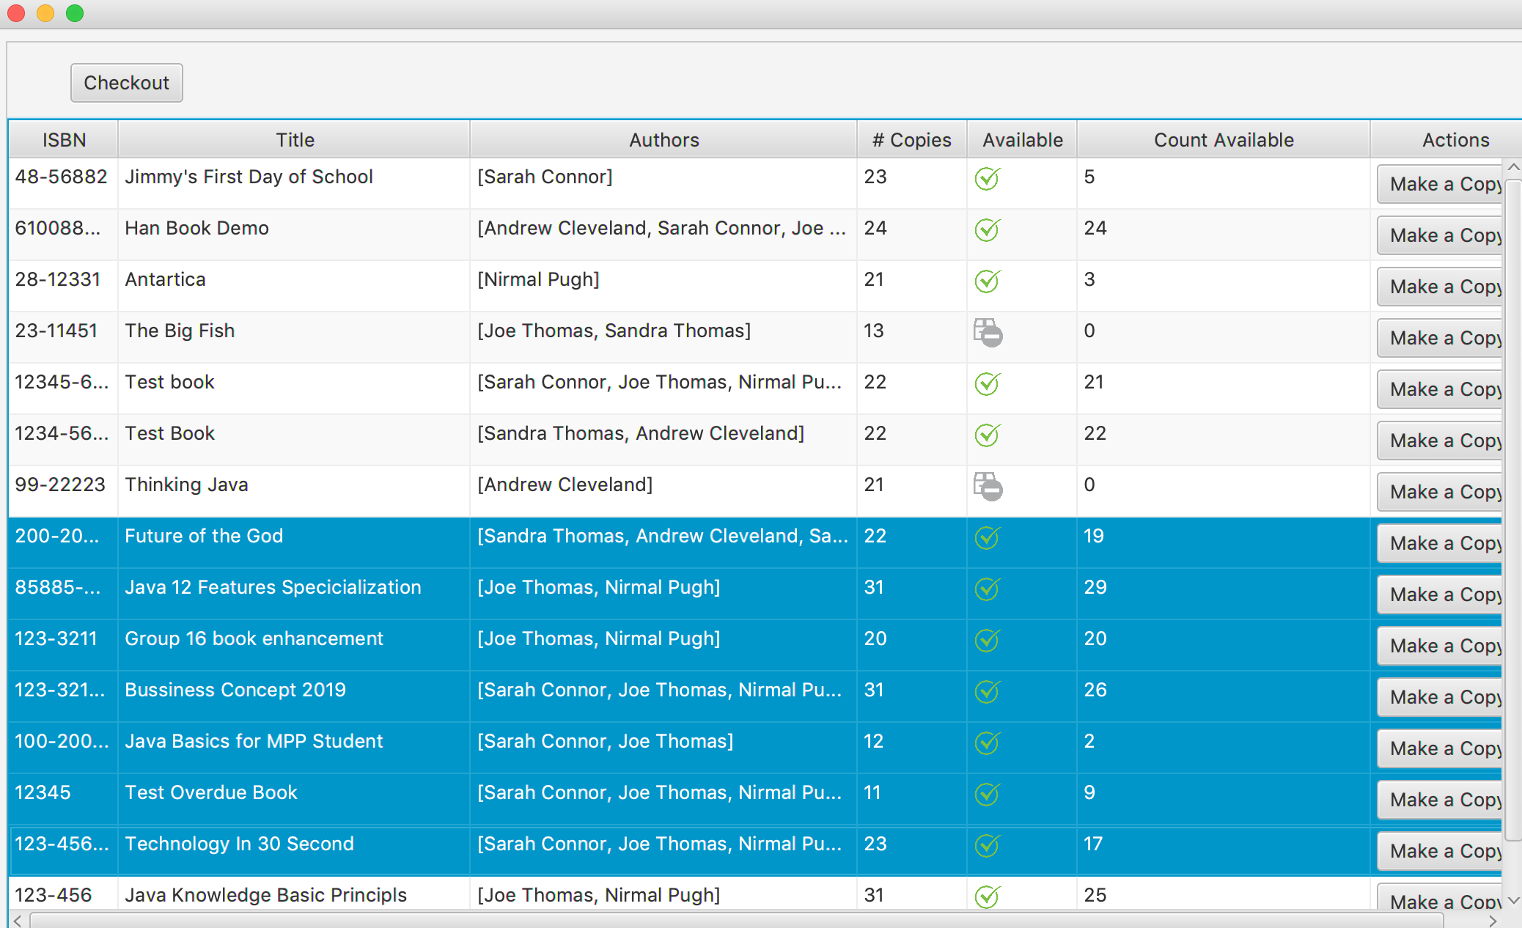
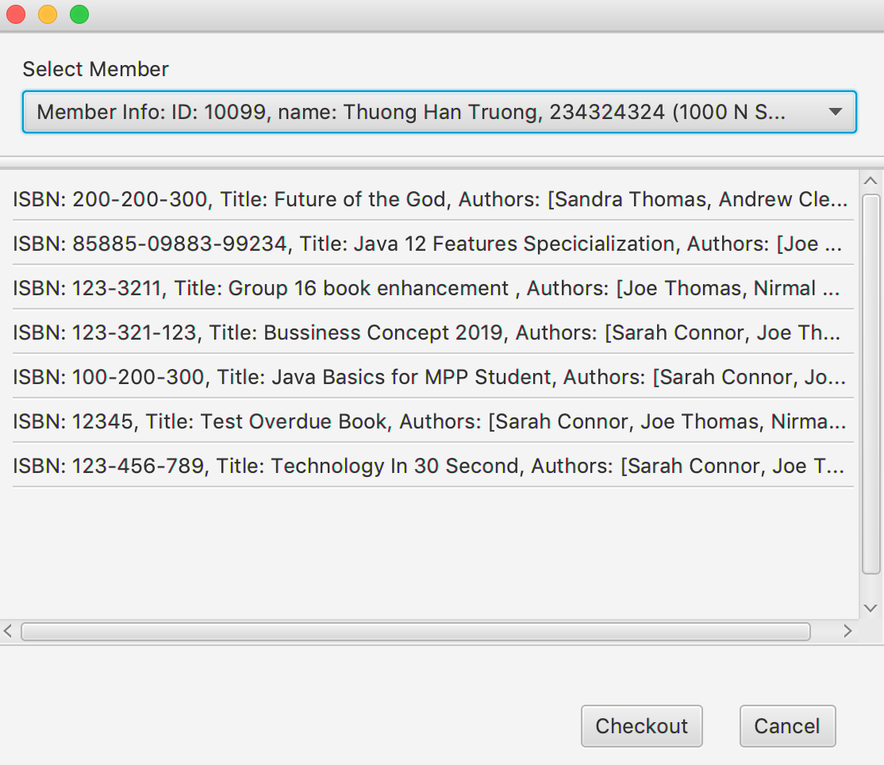
Checkout, Make a copy and more

Slide 15
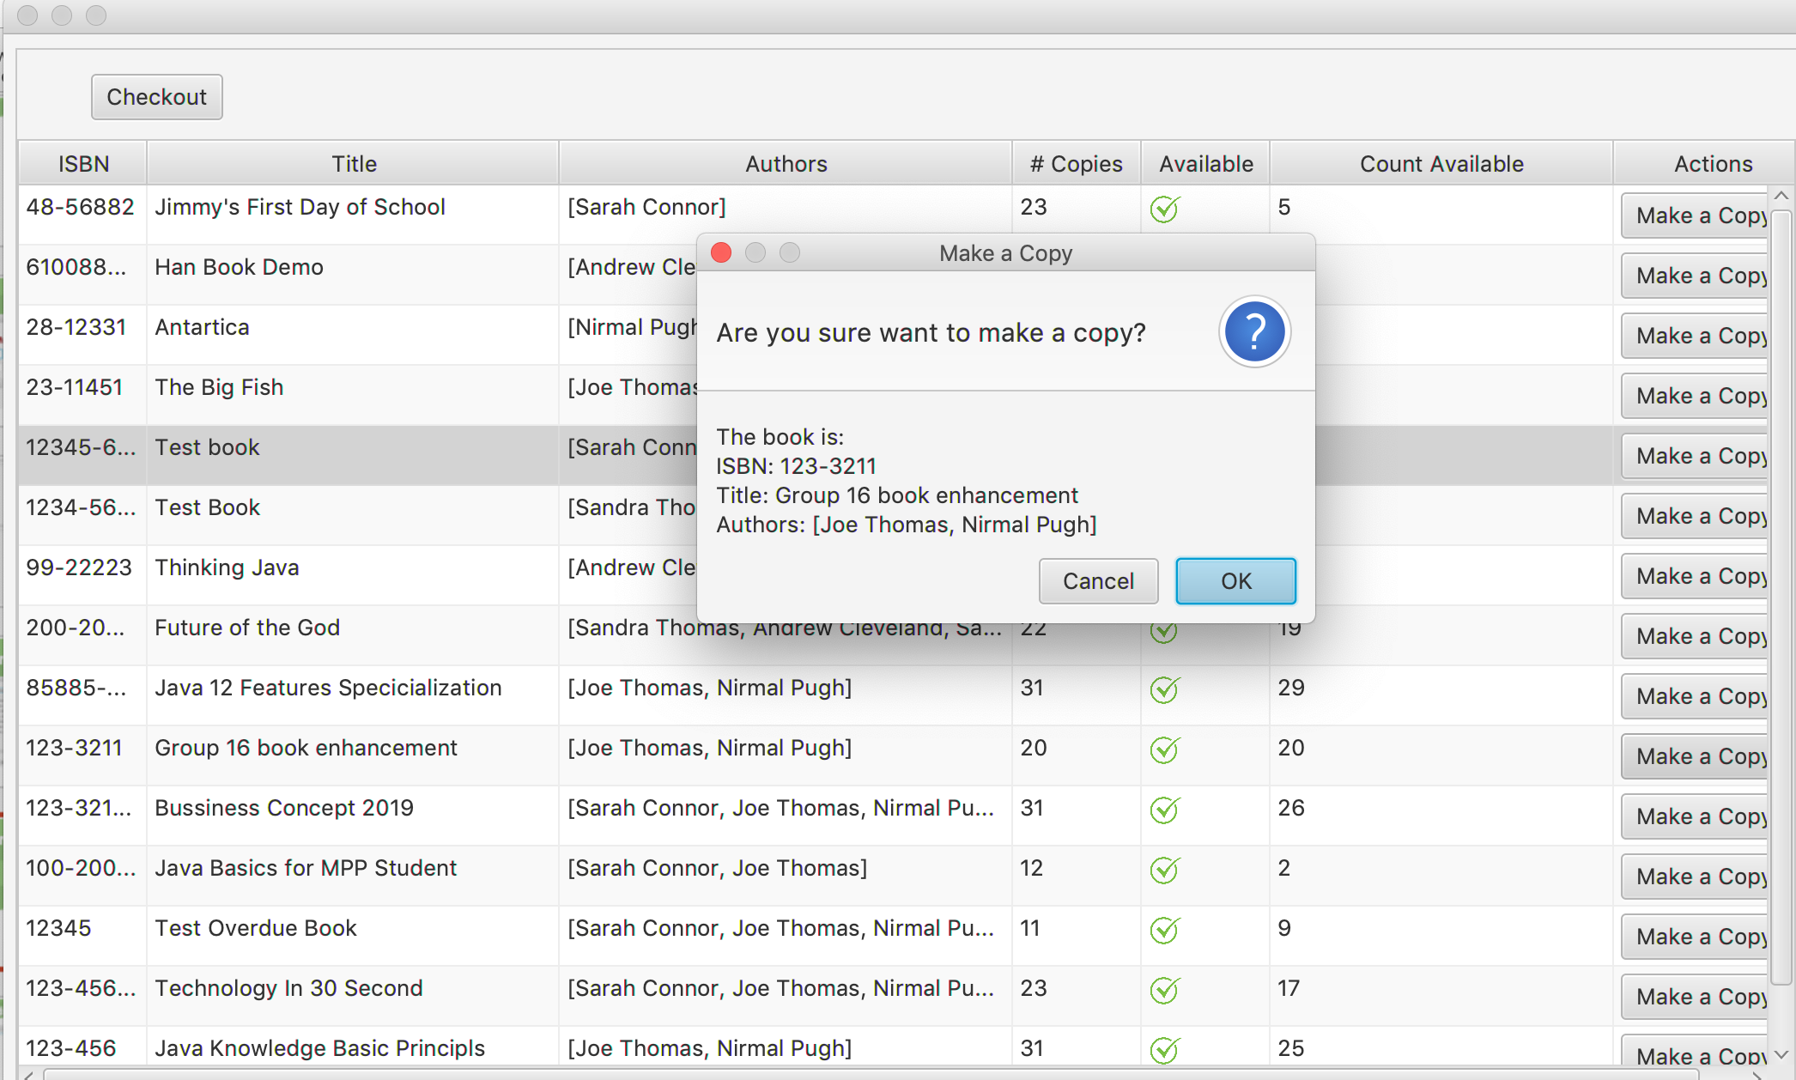
Checkout, Make a copy and more

Slide 16
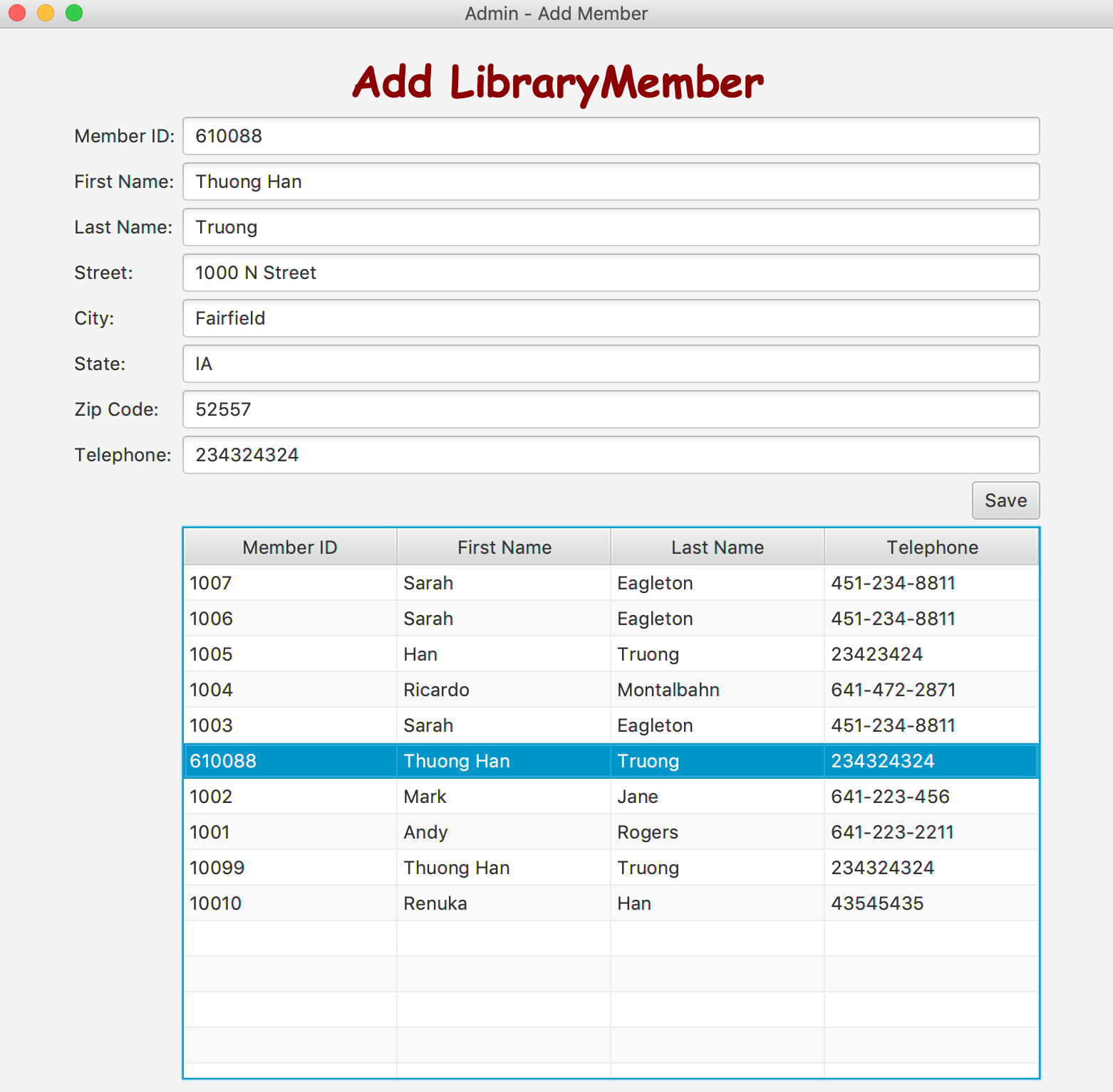
Add library member

Slide 17
Add library member
Use Case Description:
User Action | System Response
1. Authorization level of user as Administrator or both fills the form with fields: member id, first name, last name, street, city, state, zip, telephone number. Then submit to save the data. | 1. System checks validity of member id, zip, telephone number as number, first name, last name, and address as not empty. After validation the system checks existing of the member id, if the member ID is existed the data will be overridden. Otherwise, the data will be added as new member.

Slide 18
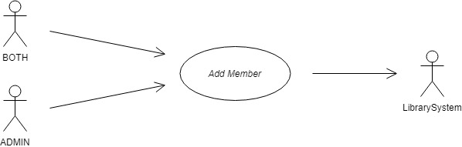
Add library member
Use Case:

Slide 19
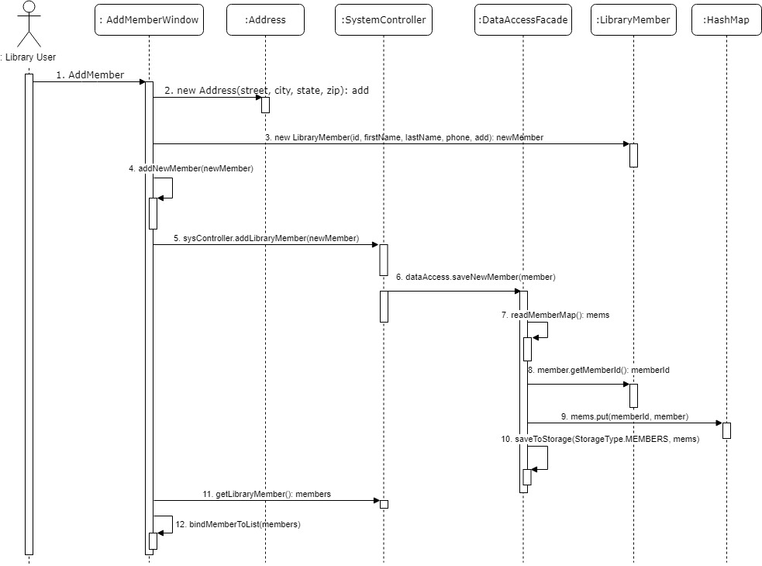
Add library member
Sequence diagram:

Slide 20
Optional Extra Features
Add book
Allows to add a book to the library. Each book can have multiple authors
Search member and print checkout records
Allows to search library member and print all book checkout history, sorted and grouped by checkout date
Search book and print list of overdue checkout

Slide 21
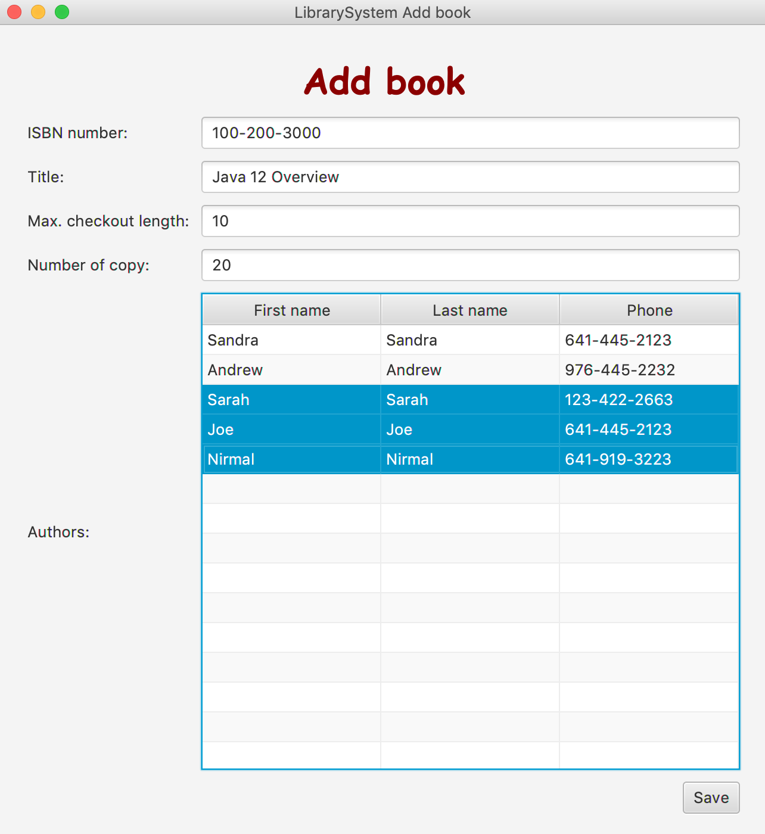
Add book

Slide 22
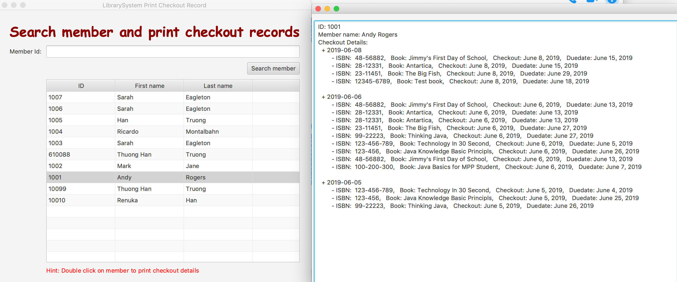
Search member and print checkout records

Slide 23
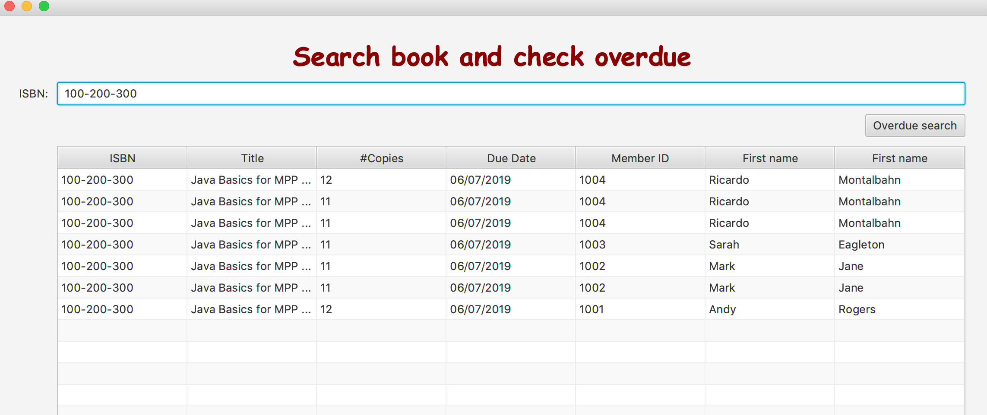
Search book for overdue

Slide 24
SCI knowledge
Knowledge is structured in consciousness. Transcendental Consciousness is the simplest state of awareness and consciousness, where the mind goes beyond thoughts and concepts to the most abstract level of awareness – the "abstract content" of awareness.
The “simplest” association is the relationship of pure consciousness to itself; this can also be modeled with an arrow from pure consciousness to itself. The pure consciousness is the field of all possibilities, the source of all solutions.
Whole is contained in every part and wholeness moving within itself: In Unity Consciousness, one recognizes that the relationship of the Self to the Self is not only fundamental, but is in reality the only relationship there is.

Slide 25
Demo
Youtube: https://www.youtube.com/watch?v=DoL4I_s_dPo

Slide 26
Source code
Github: https://github.com/chalovina/Group16/tree/master/Group16_MppProject

Slide 27
Thank you

